Slide 1
Straight to the Point: Online Learning Strategies Modules that Consider and Address Functional Impairments
For students with disabilities
Presented By:
Candice Kavanagh, Jordyn Tremblay and Amanda Blais
Notes:
30-45 minute presentation
Please feel free to set to speaker view

Slide 2

Land Acknowledgement
We would like to acknowledge the Algonquin nation upon whose traditional and unceded territory we work and live.
Image: Carleton University, Ottawa, ON
Notes:
Amanda
We encourage you all to take a moment to acknowledge land that you are on. As we are located in Ottawa and presenting on behalf of Carleton University, we would like to acknowledge the Algonquin nation upon whose traditional and unceded territory we work and live.

Slide 3

The PMC
The Paul Menton Centre for Students with Disabilities (PMC)
- Is the designated department at Carleton University coordinating disability services on campus.
- PMC works in partnership with the Carleton community to increase accessibility and integration of students with disabilities into all aspects of university life.
Notes:
Amanda
Everyone introduces ourselves

Slide 4

Presentation Overview
Objectives, goals and existing resources
What makes our modules unique?
Future directions
Q & A
Notes:
Amanda

Slide 5
Objectives
Objectives of LS Program
Decrease need for accommodations
Build academic and metacognitive self-regulation skills
Objectives of Online Modules
Immediate access to content
Introductory information
Less intensive intervention
Continued access to tools and information
Notes:
Amanda
Our office has seen a consistent increase in students registering with Disability/Accessibility Services each year. Over time, this puts a strain on accommodation services in terms of space and staff.
While we obviously believe in the importance of accommodation, we are seeing more and more students whose needs can be better addressed by individualized learning strategies support or a combination of the two. Providing learning strategies support that considers and addresses the functional impairments students experience as a result of their disabilities can, 1) decrease the need for accommodations, and 2) allow them to actually build their academic and metacognitive self-regulation skills, which are generalizable to other life domains including the workplace.
Although we feel that it is extremely worthwhile, focusing on and increasing the number of one-on-one appointments with students this also puts a strain on staff time. We decided to create online learning strategies modules to address this and more.
Mitigate the waiting period in peak times by providing students with some learning strategies content they can access immediately.
Provides an introduction to the content covered in individual sessions, so it can save some time in the one-on-one sessions and also ensure the student and learning strategist are “on the same page” in terms of basics and using the same language, etc.
Sometimes are sufficient for students requiring less intensive intervention.
Students will also have access to them for the entirety of their academic career, so they can revisit them for a refresher or come back to download a new tool to try.

Slide 6



Existing Resources
Learning supports for the general population
On Campus
CSAS covers over 19 topics
Academic Integrity
Managing Procrastination
Working in groups
Off Campus
(often online)
Notes:
Amanda
At Carleton as with several post-secondary institutions we have a generalized Learning Support Centre for all student. Our Centre for Student Academic Support currently offers over 19 online workshops for various learning skills, PASS sessions, on one one writing support etc. In addition, we have a science student success centre, Math tutorial centre and an Engineering Support Service for first year students. And that is not including the thousands of online channels and courses that student use like the Khan Academy, College Info Geek, Skill Share and more.

Slide 7
Existing Resource Gaps
Formatting/Navigation
Difficult for screen readers
Text Heavy
Missing Tangible Tools
Assistive Technology Resources
Fillable Templates
Generic and Broad
Often too long (in time and content)
Doesn’t consider variance of learners
Notes:
Amanda
Gaps
Formatting/navigation
Difficult for screen readers
Text heavy
Missing tangible tools
Missing AT
Doesn't consider functional impairments
Too long - not feasible/sustainable/interesting

Slide 8

Our Goals
Notes:
Candice
In keeping with principles of Universal Design for Learning, we wanted to ensure that both the module delivery and the module content considers and addresses the functional impairments our students experience as a result of their disabilities.

Slide 9
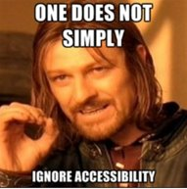
Accessibility
  Delivery
    Organization and presentation
    Accessible features
  Content
    Specific strategies that pertain to functional impairments
    Downloadable resources and tools
Notes:
Jordyn
Making sure the module Delivery (the organization, presentation, and accessible features) and Content (strategies, downloadable resources, and tools) follow Web Content Accessibility Guidelines (WCAG) standard https://www.w3.org/WAI/standards-guidelines/wcag/
Headings
Colour contrast
Text size
Linked content
Meme: https://a11ymemes.tumblr.com/post/24060714025/one-does-not-simply-ignore-accessibility
CAST info
http://udloncampus.cast.org/page/teach_executive

Slide 10
Metacognitive Self-Regulation
Recognize
Action
Reflect
Adjust (if needed)
Identify area for development
Learn and implement tools
Reflect on tool effectiveness
Adjust
Notes:
Amanda
Metacognition the ability to reflect critically on learning processes and experiences in order to inform future progress (Owen & Vista, 2017)
Self-determination Theory
Growth Mindset
Strength Based Approach
Specific points about metacognitive tips
Reflection tools
Responding to responses
-Info for LS
-Engaging for students
When it comes to disabilities that affect executive functioning disabilities (i.e. ADHD, mental health disabilities, ASD, etc. ) not only is it important to understand how you think/learn, but it’s also as important to then understand how to identify the tools that best help you to regulate the tools/time it will take to learn/understand.
MAESD’s Guiding Principles for Experiential Learning: 1 = supported/linked to workplace, 2 = meaningful, structured, and verified, 3 = Compliant with laws, 4 = Recognition (Not sure if this applies and we want to use it)
As our LS supports can be generally applied across disciplines, but specified to the learner, we wanted to encourage students to try to practice these skills not just in their courses but their volunteer and workplaces as well.
- We know that one of the most important pieces to experiential learning (aside from applied knowledge to practice) is the reflection of that application (P. Brown, H.L. Roediger III and M.A. McDaniel (2014). At the end of each module, we ask students to reflect on what they have learned and in what ways they will apply the tool(s) to other areas. We then take to the time to individually respond to each student and save the response in their student file. That way in the future, if the student discusses with their coordinator that they are experiencing a similar issue the coordinator can remind them of what has worked in the past.

Slide 11

Activity – Join Our Poll
Notes:
First thing to cut

Slide 12

What makes our modules unique?
Notes:
Candice
We worked to address the gaps we noticed in other modules. When it came to how we delivered the modules, we ensured that the organization and presentation was accessible and that we included accessible features. We also wanted to make sure that our content was accessible in that it contained specific strategies that pertain to functional impairments and to also include downloadable resources and tools.

Slide 13
Functional Impairments Addressed by Module Delivery
Attention/concentration
Executive functioning
Reading disabilities
Mental health
Motor/physical
Memory and processing
Notes:
Candice
Many of our students have difficulty with attention and concentration and modules (or even lectures!) that take a couple of hours are too lengthy for them to sustain their attention to the end.
Online learning requires students to be far more autonomous, and is more taxing on executive functioning skills in particular. Online modules or courses that are in too large of a chunk or disorganized are incredibly difficult to follow.
Modules that are text only can be daunting for students with reading disabilities, and may even take much longer if they are not easily read by reading software.
Students with memory or processing impairments often aren't able to retain a great deal of information or content without multiple viewings, so long modules are too time consuming.
Students with mental health disabilities may feel overwhelmed by lengthy modules, and many online courses don't consider how mental health may impact functioning/abilities.
Online modules can be poorly set up for screen readers, and online quizzes sometimes require a lot of writing, which creates barriers for students with motor or physical disabilities.

Slide 14
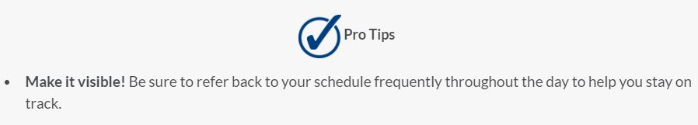
Organization and Presentation
  Short overall duration
  Clear and logically-ordered
  Comprised of several smaller sections
  Can be completed in parts or as a whole
  Video content (work in progress)
  Concise
Notes:
Candice
We attempted to organize and present our module content in a way that addresses those functional impairments.
We worked hard to keep our modules fairly short overall, despite the fact that we could talk for hours about each topic! If students with memory or processing difficulties want to re-watch them, we didn't want them having to spend several hours on these to retain the content.
To make our modules less taxing on students' executive functioning skills, we made sure sections were labelled clearly and were in a logical order. We wanted them to flow in an intuitive way to reduce confusion and stress.
Each module is also broken down into even smaller sections so that students can easily go through the entire module at once or do it in parts.
We included time estimates for each section. This allows students to consider how attentive or energetic they feel and then decide how many sections to go through, or which ones, which is helpful for students with attention difficulties and mental health disabilities in particular.
We included several videos to try to cut down on the text and so students have more than one way to get the information. We started by choosing videos on YouTube that covered what we wanted, but we plan to create some of our own in the future that will match up more exactly with what we envision.
We tried to present the content in a concise manner, giving students information that is straight to the point. Each module subsection also contains a bulleted list of pro tips.
We made sure our content is easy to follow with a screen-reader so that students don't need to do a lot of clicking to discover what they need to look at. We don't have many spaces for written content as our quizzes are multiple choice. Next, Jordyn will give more detail about the accessible features of the modules.

Slide 15
Accessible Features
Captioning
Screen reader accessible content
  Hearing impairments
  Auditory processing
  Executive functioning
  Visual impairments
  Reading comprehension and decoding speed
  Motor difficulties
  Executive functioning
Notes:
Jordyn
Caption videos aids individuals with the following functional impairments:
Hearing impairments - so they can know what sort of auditory information is being covered in the videos
Auditory processing - by providing a text-based medium that they can review as they listen to the video
Executive functioning - the option to have both visual and auditory information to make it easier on working memory
Also helps:
English as a second language learners
Anyone reviewing the module content in a noisy environment
Screen reader accessible content helps individuals with the following functional impairments:
Visual impairments - so they will be able to both navigate through the module and here any text based information
Reading comprehension and decoding speed - they will be able to use text-to-speech reading software to make it easier to process the text based information and minimize the amount of time they would need to spend reading over the information
Motor difficulties - the requirements for screen reader accessible content to have a clear reading order, a logical order to text headings, and minimizing the number of clicks/drag-and-drop features also improves the accessibility for anyone that would find it difficult to navigate a webpage with your average computer mouse
Executive functioning
Also helps:
Individuals who like to copy and paste text into their reading notes
Any student who would just like to navigate the page with their keyboard instead of a mouse

Slide 16
Functional Impairments Addressed by Module Content
Executive functioning
Reading and writing disabilities
Memory and processing
Mental health
Motor/physical
medical/medication
Time perception
attention
concentration
Notes:
Candice
The content covered in many online modules contains suggestions that would work for most people, however, we feel that it is important and sometimes quite easy to include ideas in module content that would consider our students' functional impairments. By doing so, we wanted to let them know that they aren't alone and that there are strategies available to help them build on their skills, despite the challenges they face, and to provide them with tangible tools they can use.
We made sure to explain how the strategies we present in our modules take into account the functional impairments, or how they can be adapted to do so.
Things we considered when creating our time management module were:
Many students with ADHD have time perception deficits.
Students with attention/concentration difficulties, reading/writing disabilities, memory issues, mental health disabilities, medical issues or medication side effects, and motor/physical difficulties might take longer than average to complete school work.
Students with ADHD or mental health disabilities have difficulties with task initiation.
Students with mental health disabilities or medical/motor/physical disabilities might not have the cognitive or physical stamina to do certain tasks for as long as students without those disabilities.
Students with any disability might need to spend time managing their disability and that needs to be taken into consideration when planning.

Slide 17
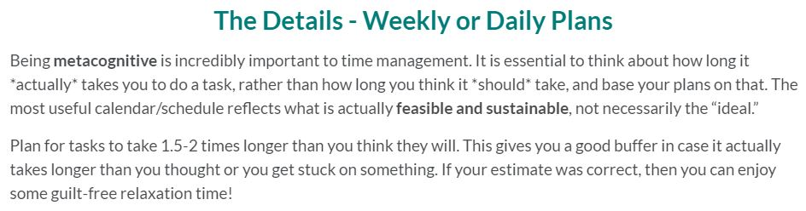
Specific Strategies
  Buffer time
  Metacognitive self-regulation
Notes:
Candice
Buffer time is a strategy we use that helps students whose disabilities can be unpredictable in nature. We use that knowledge to work "with" the functional impairment, rather than try to push against it. We advise students to add in buffer time both for each individual task (so anticipate it taking 1.5-2 times longer than you think) and for the whole assignment (making your own due date a week early, or adding in buffer days throughout your plan in between different tasks).
This helps the students who:
Experience time perception deficits
Don't work as quickly as their peers or as quickly as they think they do
Have a disability that is episodic in nature (mental health – energy, seizures and recovery)
Get distracted when working
It also allows them to take time to seek assistance in completing the task.
We consistently encourage students to practice metacognitive self-regulation. That means we want them to be constantly reflecting and evaluating how things are going, and to readjust what they are doing based on that evaluation.

Slide 18
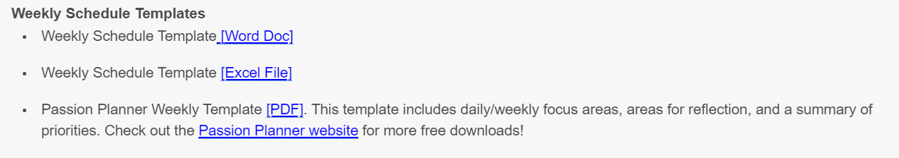
Resources and Tools
Handouts, worksheets, and templates
Editing, reformatting, and adapting
Add to the module
Notes:
Jordyn
To minimize the amount of text within the module that we would need to explain how to use a particular strategy we included several handouts, worksheets, and templates.
These documents came from the resource manual that PMC learning strategists have added to over the years (The LS Bible).
Prior to Covid these handouts, worksheets, and templates would typically be printed out for students during learning strategy sessions so most of these documents were horribly inaccessible.
To keep a long story short, we did a lot of editing, reformatting and adapting these resources to make sure they became accessible.
Some of these resources had to be transferred into word documents to ensure that they were appropriately formatted before being turned back into PDF documents. While other documents just need some minor edits. The entire activity was helpful because it also gave us the opportunity to ensure that the information was up to date and all instructions were to the point
After document was completed, it would be added into the modules with links that indicate which file format a student would download to access the document (as demonstrated by the image on the slide).

Slide 19





Assistive Technology
Apps and Software
Descriptions or demonstration videos
Criteria for assistant technology selected
Notes:
Jordyn
In addition to handouts and worksheets we wanted these modules to contain information about different assistive technologies that can be paired with the learning strategies of the module.
For each assistive technology there is either a brief demonstration video or a short text based description of the key features of that application or software.
Multiple recommendations for the same strategy To demonstrate the multiple technologies with similar features exist.
Most of the programs and applications mentioned module were specifically chosen because the price point was either free or low-cost. Technologies that are not free are identified in their descriptions and it is recommended that students meet with an assistive technologist before purchasing any technology.
Time Management:
Pomodoro Timers (for example clockwork tomato)
Habit Tracking Applications (for example don't break the chain)
Calendar Applications (for example Outlook calendar)
To Do List Applications (for example Microsoft to Do)
Studying:
Quizlet
Study Buddy App
Notetaking:
OneNote
Glean
Coggle
Quizlet (again)
Writing (to be published soon):
diagrams.net
Workflowy
Microsoft Dictate
Voice Typing
Microsoft Immersive Reader
Easybib
Microsoft Citation Generator
Microsoft Editor
Grammarly
Demonstration time!

Slide 20
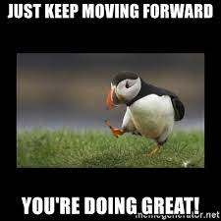
Future Directions
  Create videos
  Reduce text further
  Instructions for navigation
  Modules covering:
    Additional academic skills
    Self-regulation skills
    Assistive technology resources
Notes:
Candice
While we have attempted to consider and address the functional impairments our students experience, we also recognize that there are still things that we need to improve.
1. Create our own videos, reduce amount of text further
2. Instructions about how to navigate module
3. Instructions for using AT?
4. Create additional modules for academic skills and self-regulation

Slide 21

Any Questions?
Notes:
All
- Although these modules were created to be more accessible for students with disabilities, they are available to any Carleton student to completed.
http://www.advisorsoftware.com/blog/wp-content/uploads/2014/08/dexmedia.jpg

Slide 22

Contact Information
candice.kavanagh@carleton.ca
jordyn.tremblay@carleton.ca
amanda.bettencourt@carleton.ca

